Slide 1
Recovering Stolen Computers and Laptops
Omari Grant
Danlil Perelshteyn
Advisor : Dr. S. Masoud Sadjadi
School of Computing and Information Sciences
Florida International University
Your Email@fiu.edu
http://www.cs.fiu.edu/~sadjadi/

Slide 2
Agenda
Problem and Motivation
Solution
Behind the Scene
Customizing the Solution
Disclaimer
Progress Report

Slide 3
Problem and Motivation:
Laptop theft is a very common problem. Specifically we will focus on the FIU environment where the school has experienced a rash of laptop thefts particularly Mac.

Slide 4

Fig 1.1

Slide 5
Solution
We will use the following agent procedures Camera Picture Capture and a few additional procedures to aid in an effort to recover stolen laptops.

Slide 6
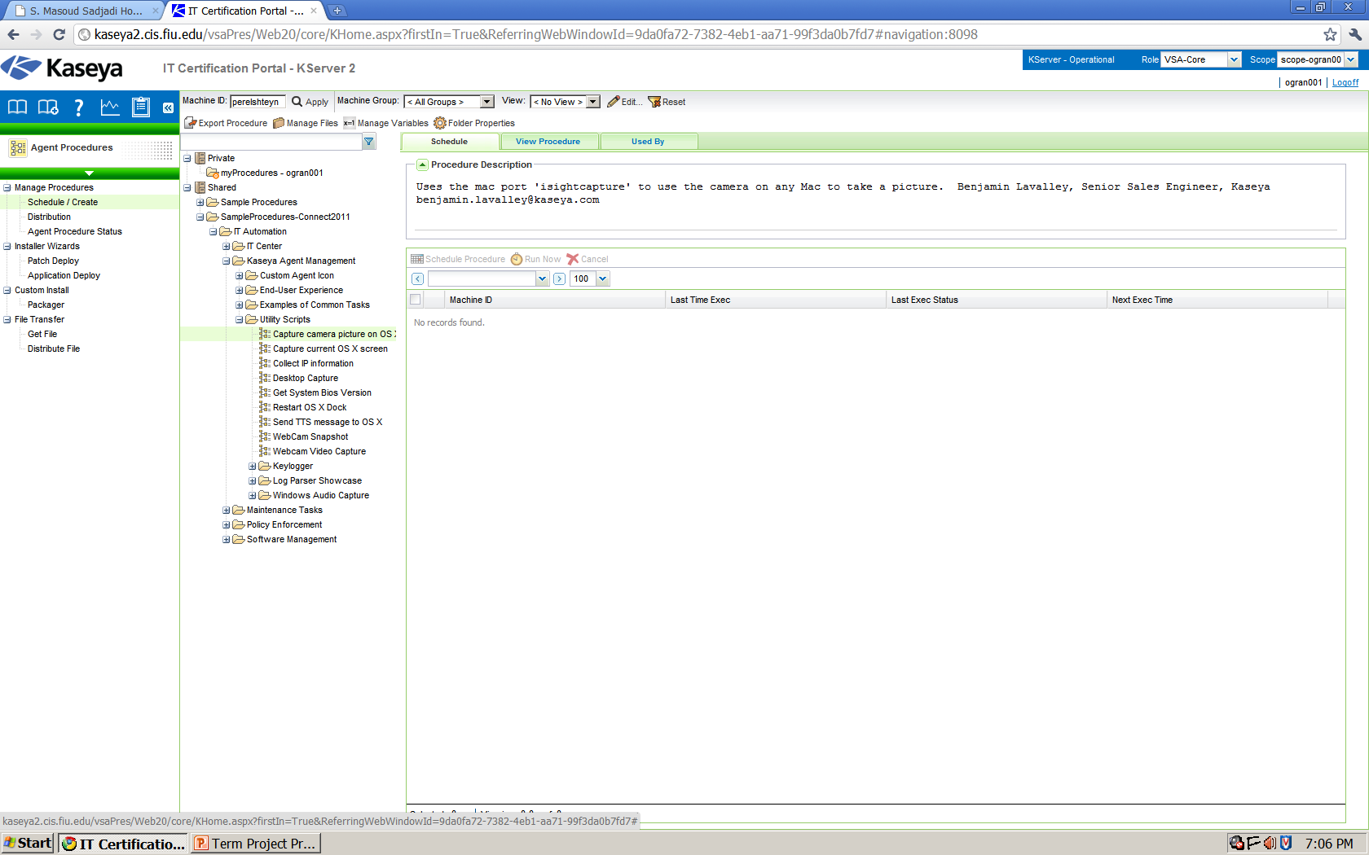
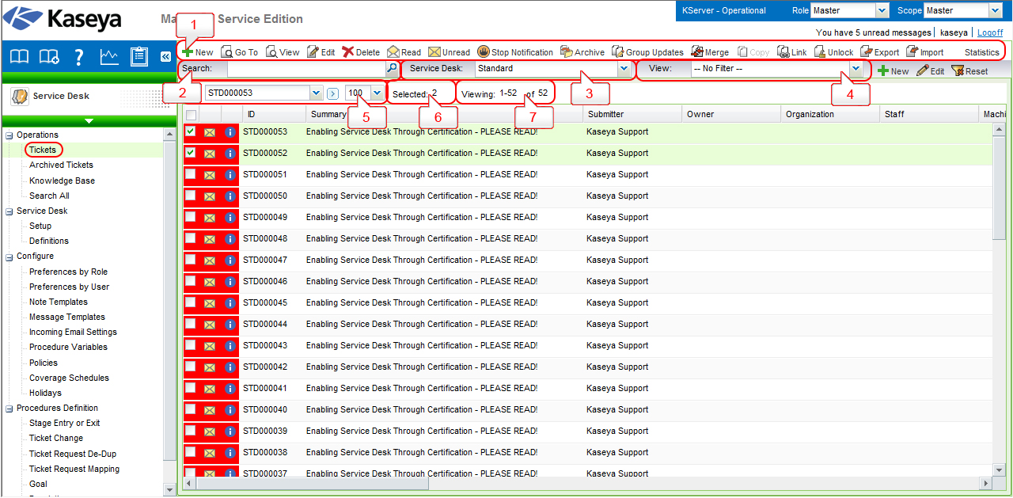
Fig 2.1

Slide 7
Behind the Scene
Capture camera uses the port “isightcapture” to turn the web camera on silently behind the scenes and take pictures of the user and stores the pictures in the Kserver.

Slide 8
Fig 3.1
http://www.theage.com.au/digital-life/computers/sprung-by-facebook-geek-justice-for-pornsurfing-laptop-thief-20090812-ehpa.html

Slide 9
Customizing the Solution
There is a lot of room for customization with this project and ideas such as expanding our range….
Include PCs in recovery
Running a script to check to see what platform the computer is before implementing any script.
Running a script to check if the computer has a webcam.

Slide 10
Disclaimer
The agents procedures are attended to work with Mac and requires the computer already have Kaseya already installed
If the computer does not have OS X or a webcamera some of the procedure will not work.

Slide 11
Progress Report
We understand how the solution works in the environment but we are still researching and brain storming the best way to implement these procedures into the current environment.
We have tested a few of the procedures but not all of the procedures have been tested so not all of them can be guaranteed to work.

